Slide 1
Coordinate systems and transformations

Slide 2
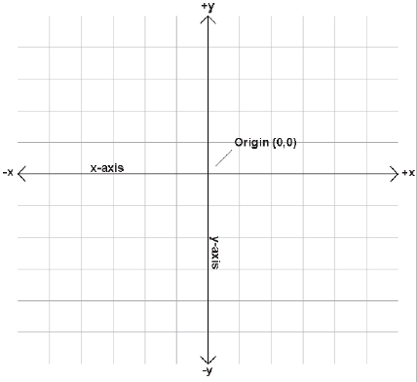
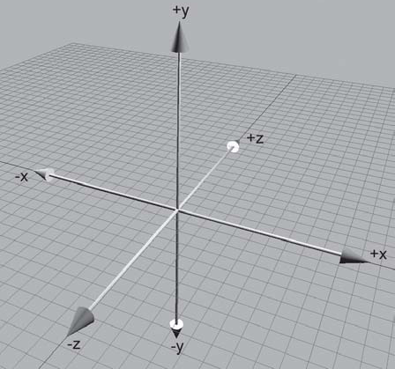
Cartesian coordinate space
A 2D Cartesian coordinate space
A 3D Cartesian coordinate space

Slide 3
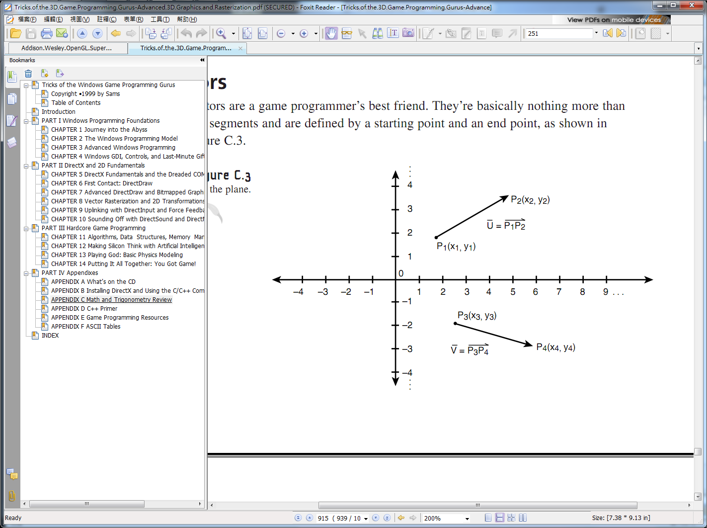
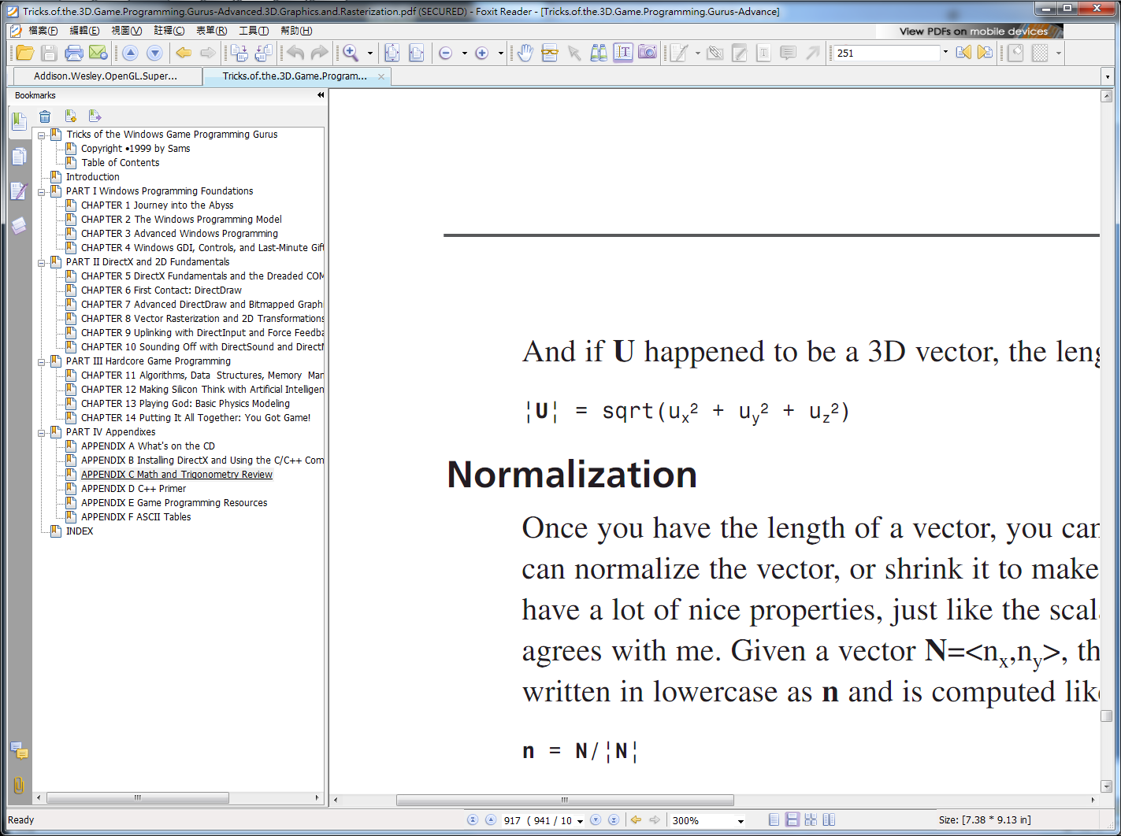
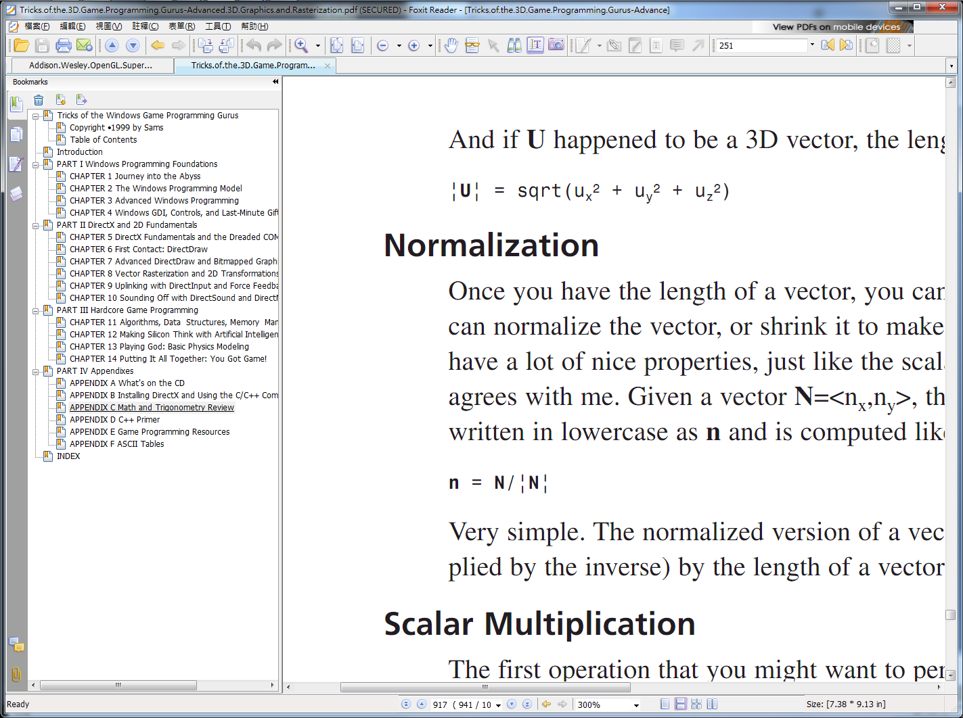
Vector (1/4)
Vector3.h
U = p2 – p1 = (x2-x1, y2-y1, z2-z1) = <ux, uy, uz>
Vector Length
Normalization
Vectors in the plane

Slide 4
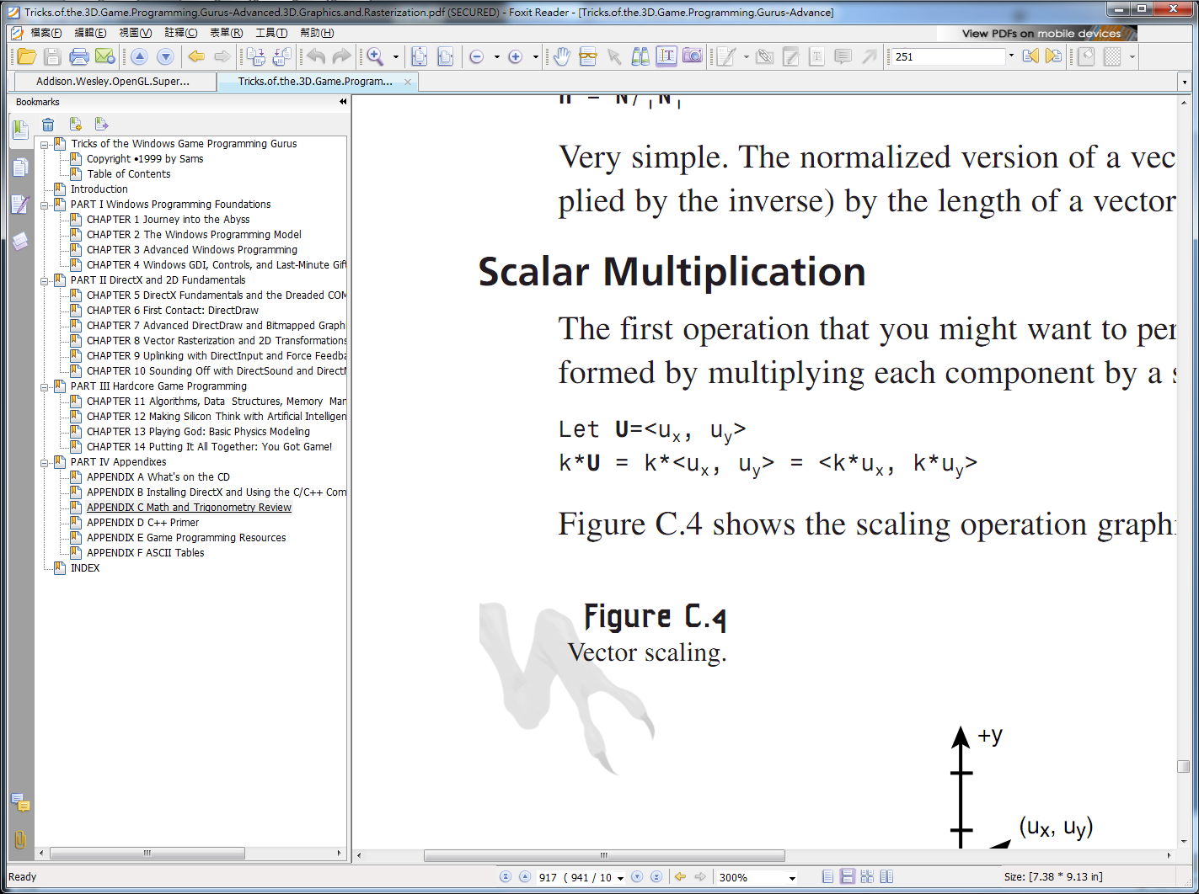
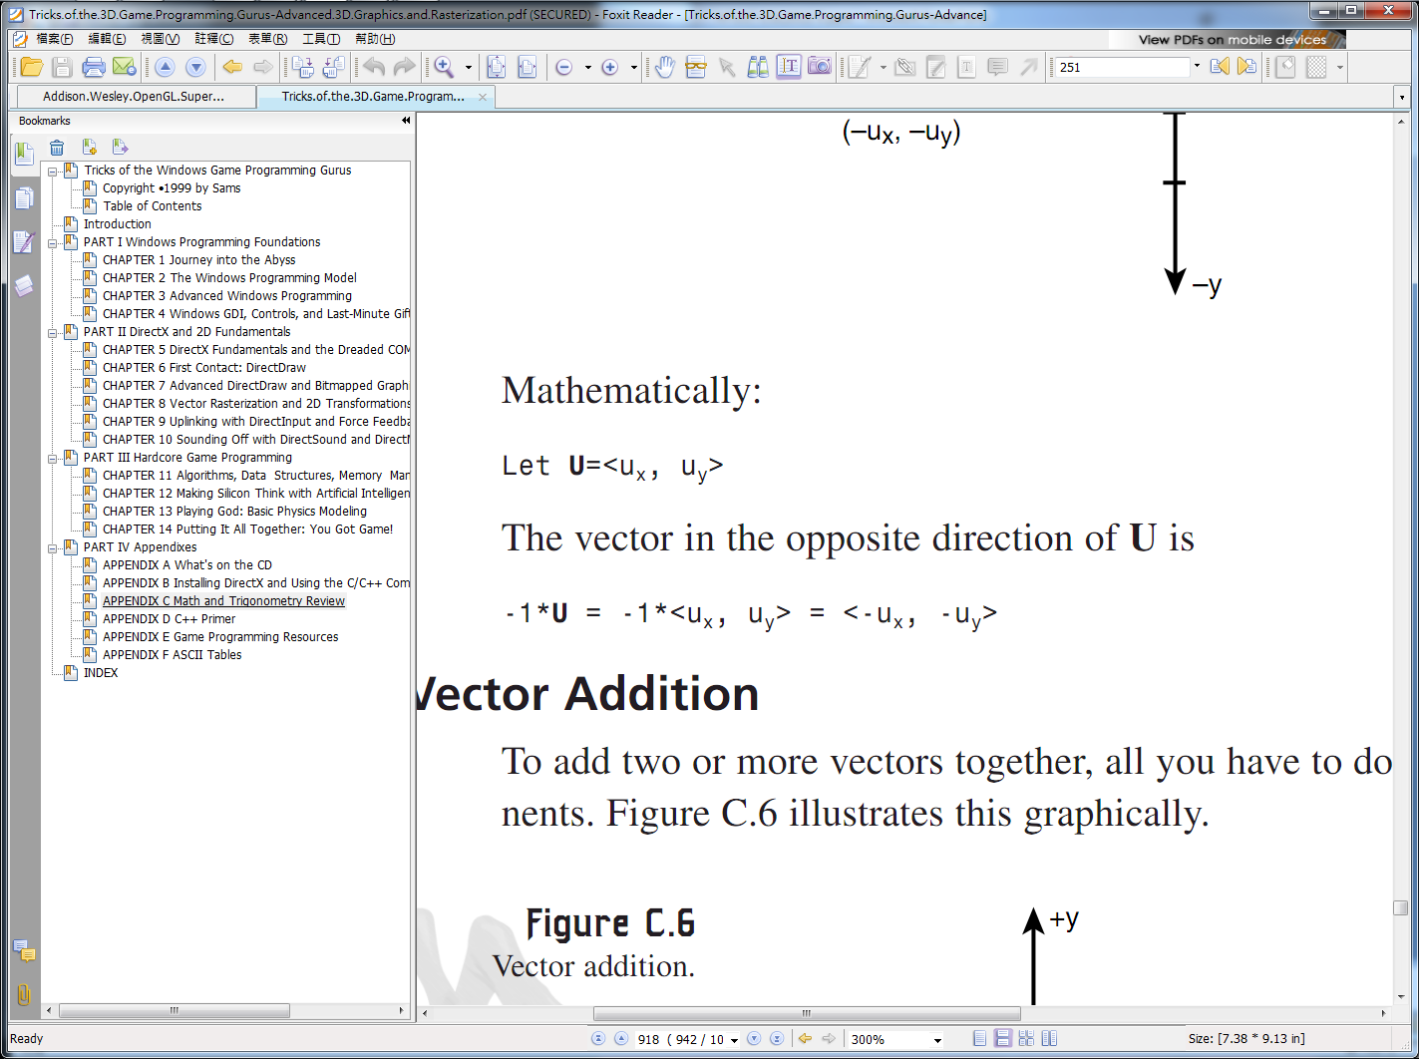
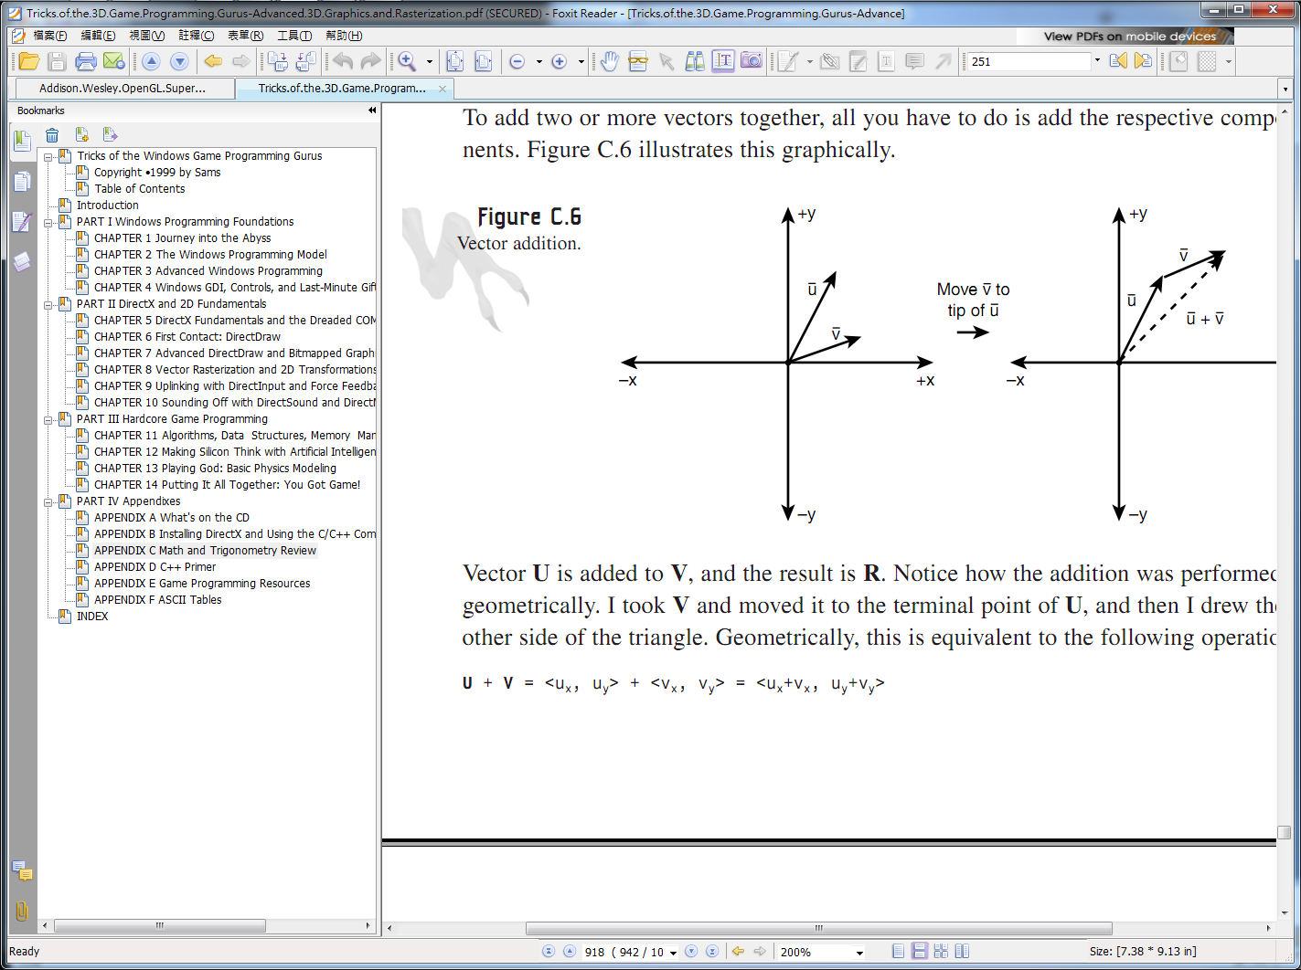
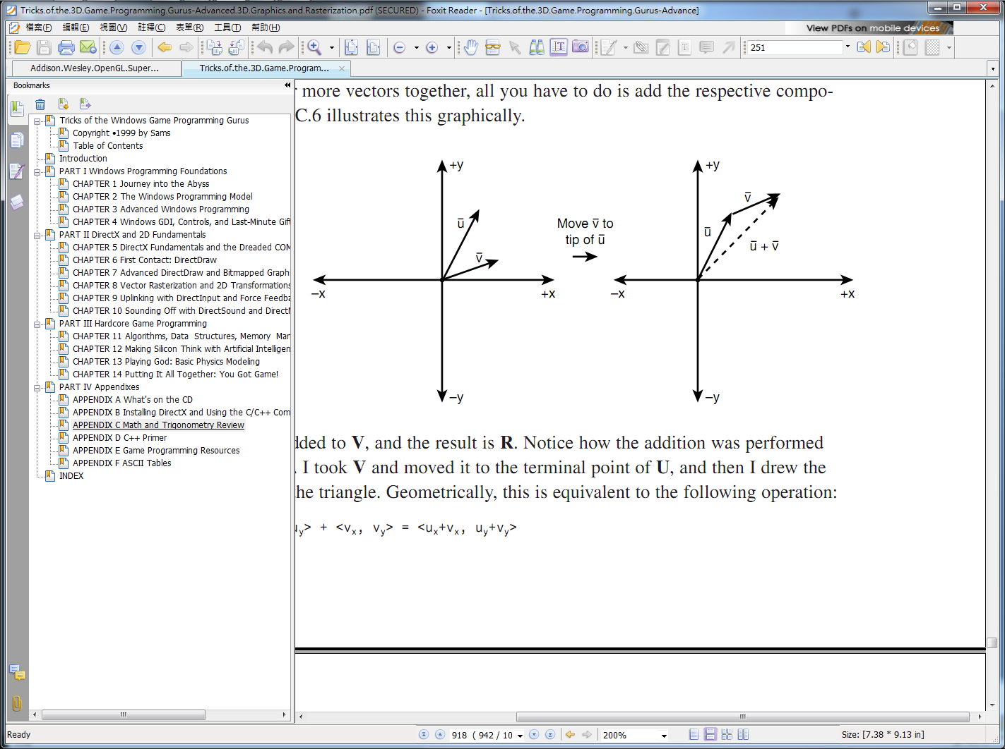
Vector (2/4)
Scalar Multiplication
Vector Addition

Slide 5
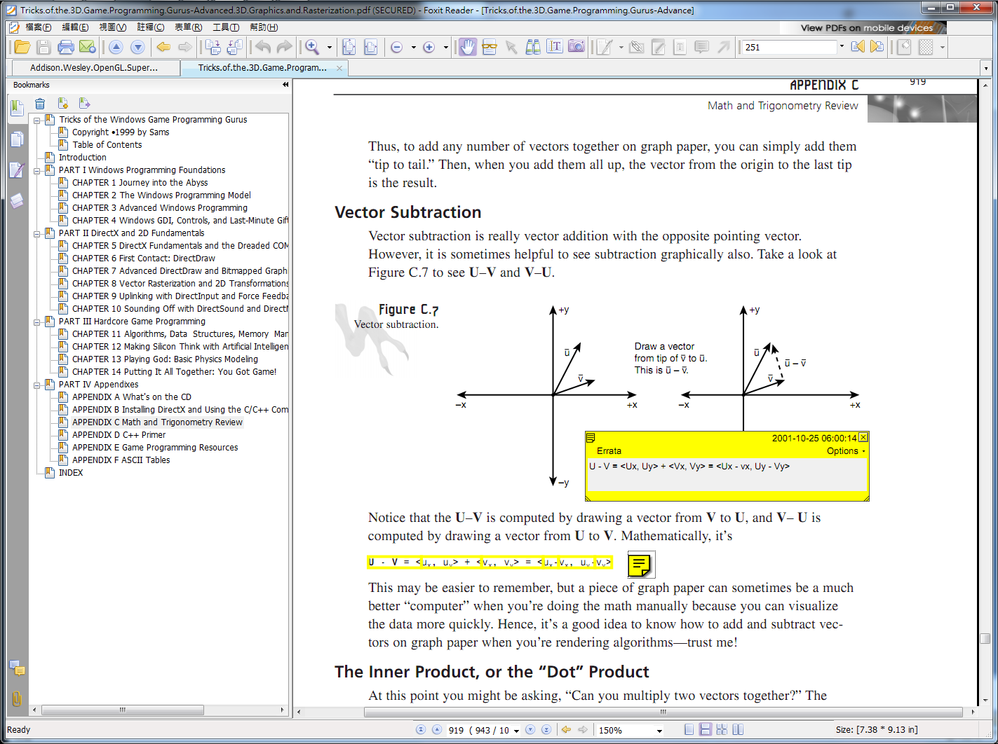
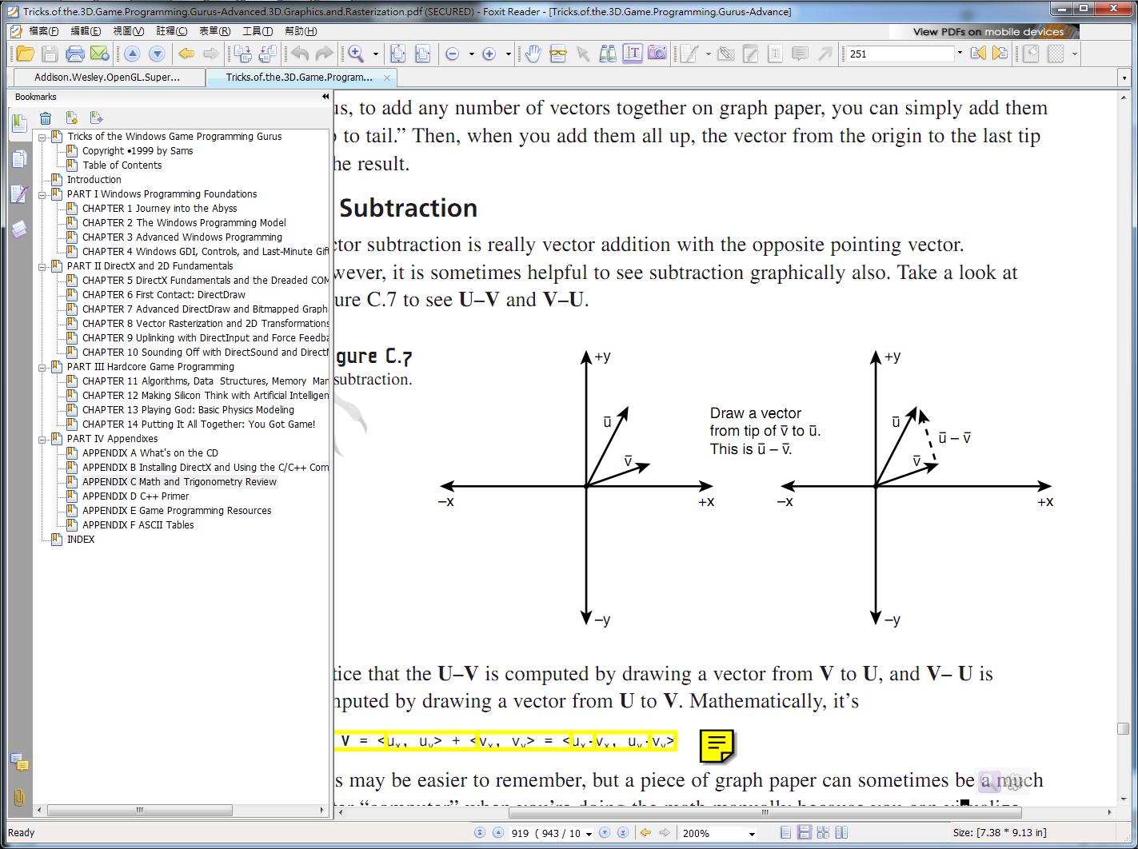
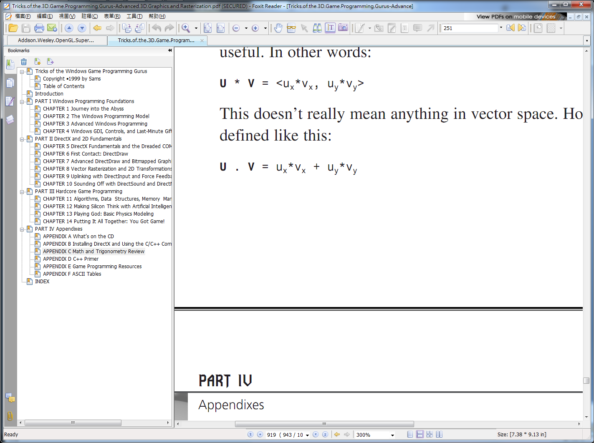
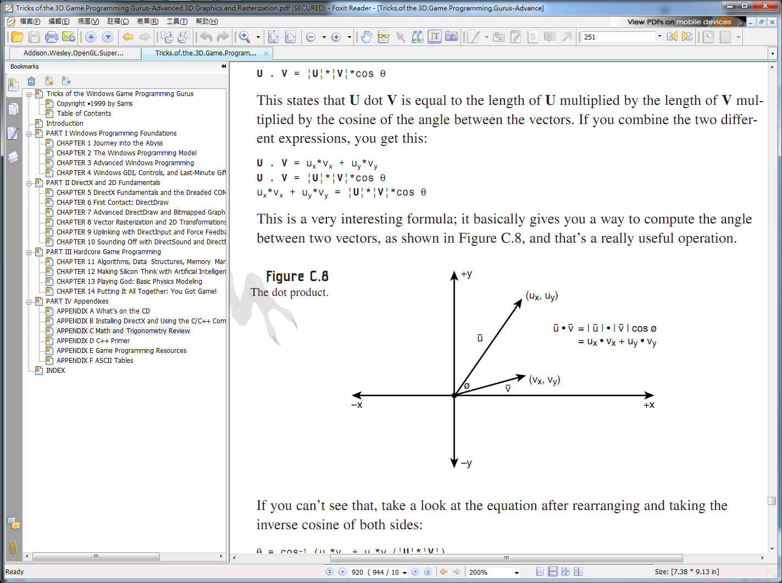
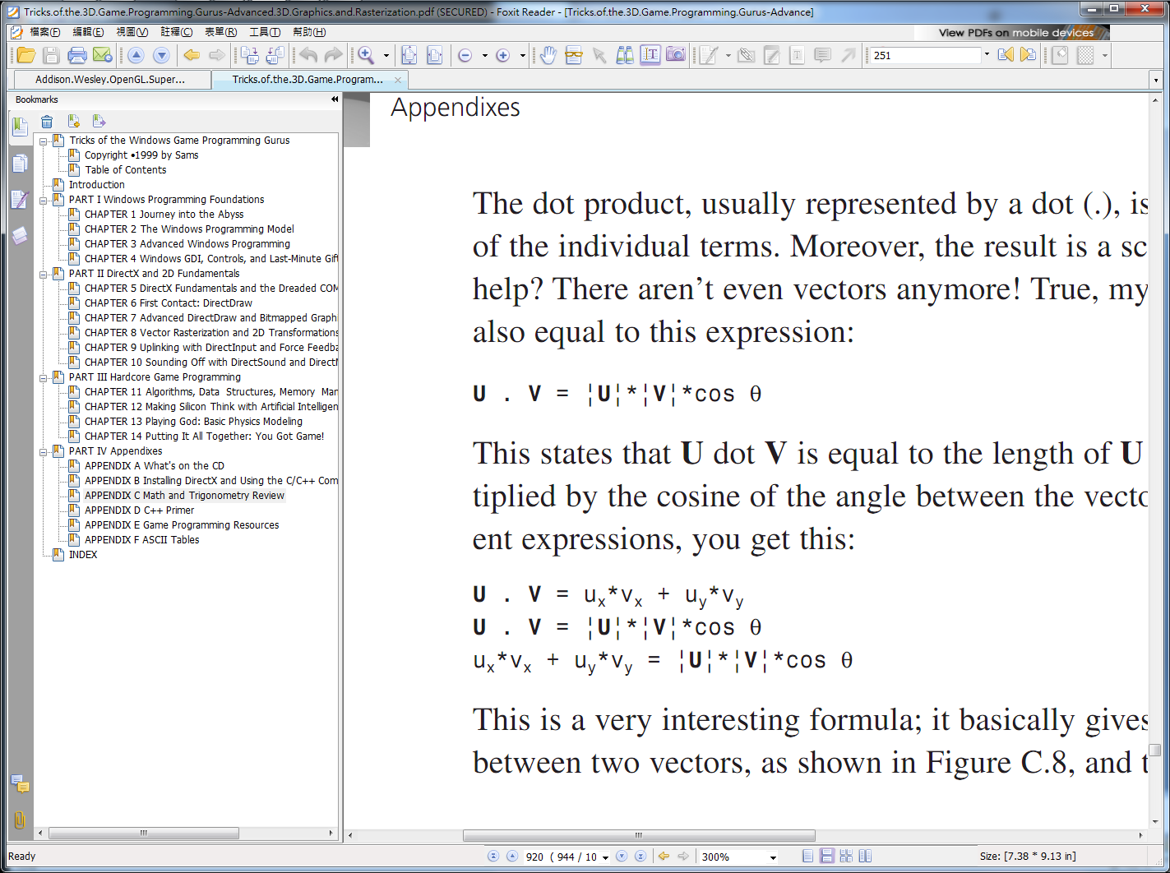
Vector (3/4)
Vector Subtraction
The Inner Product, or the “Dot” Product

Slide 6
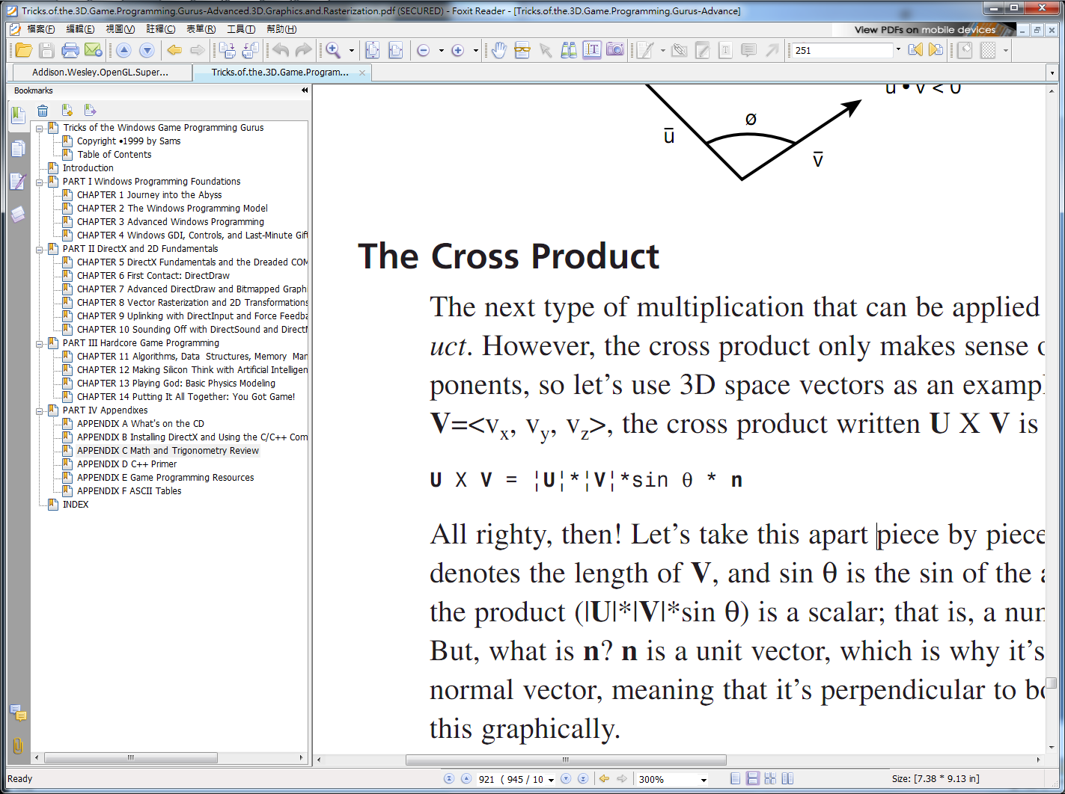
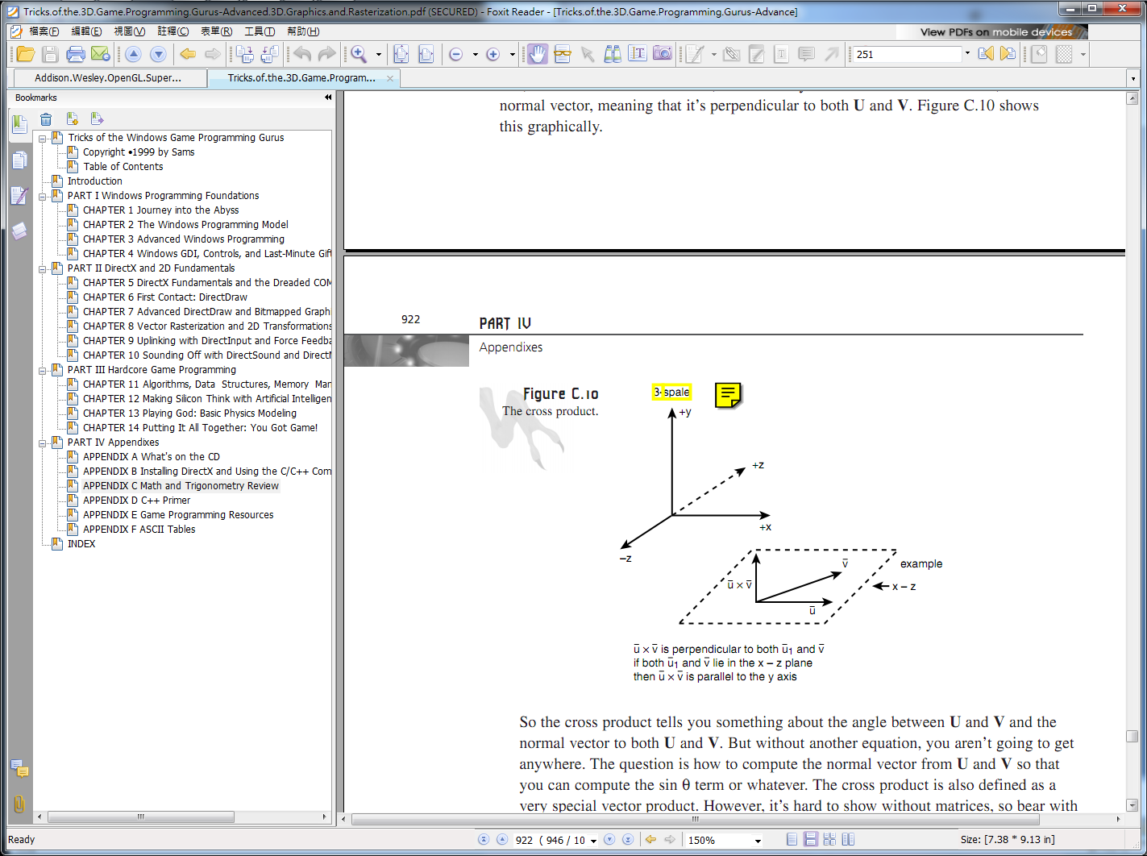
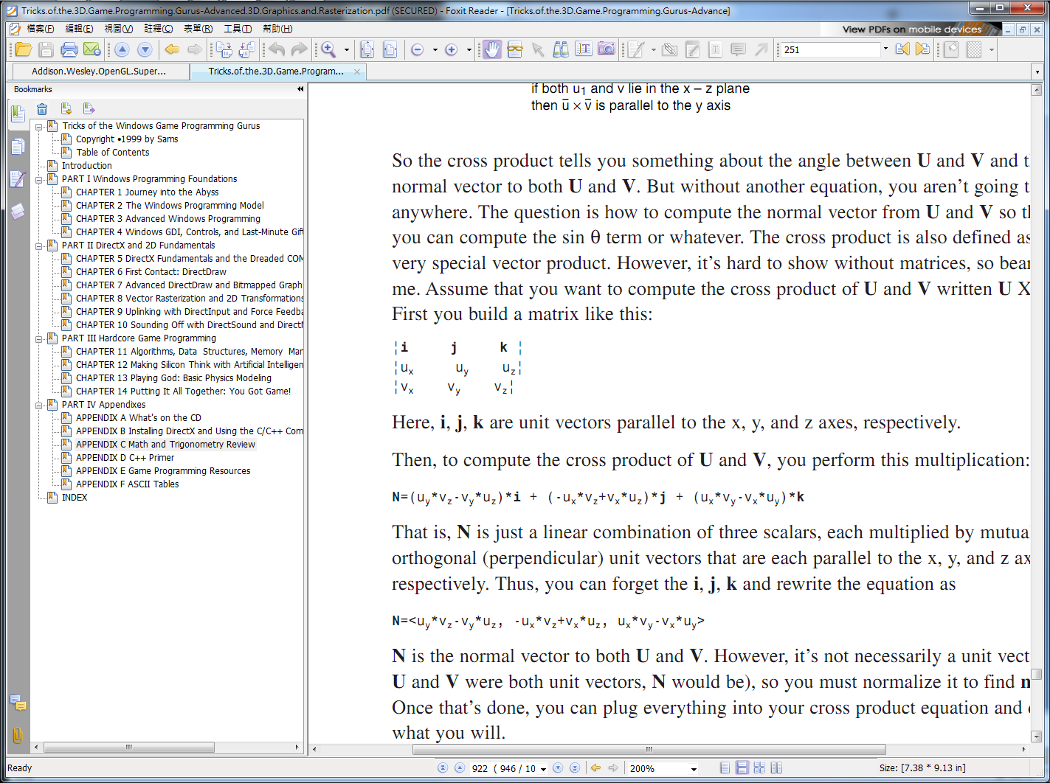
Vector (4/4)
The Cross Product

Slide 7
Matrix
Matrix

Slide 8
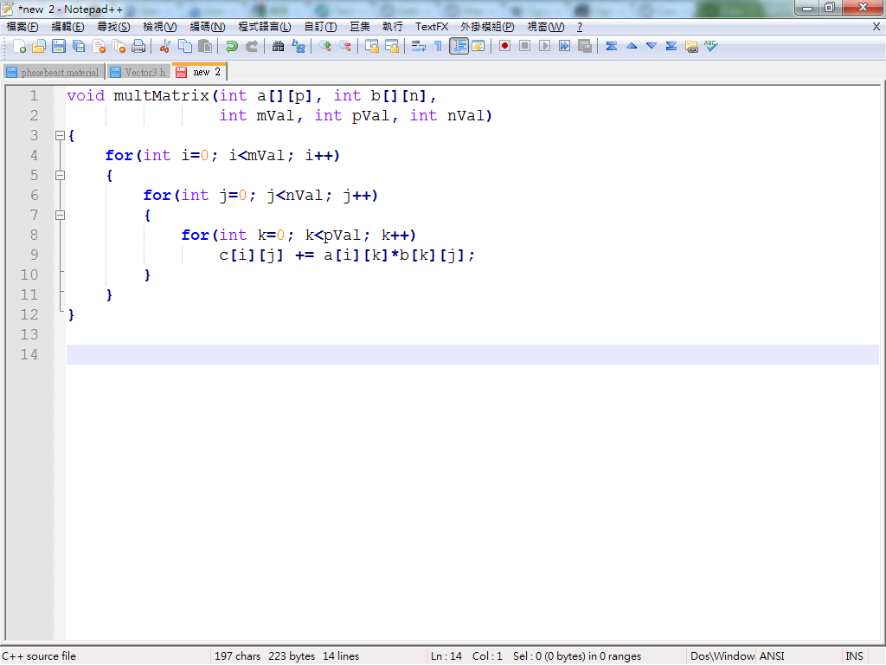
Matrix
Multiply Mmxp with Mpxn

Slide 9
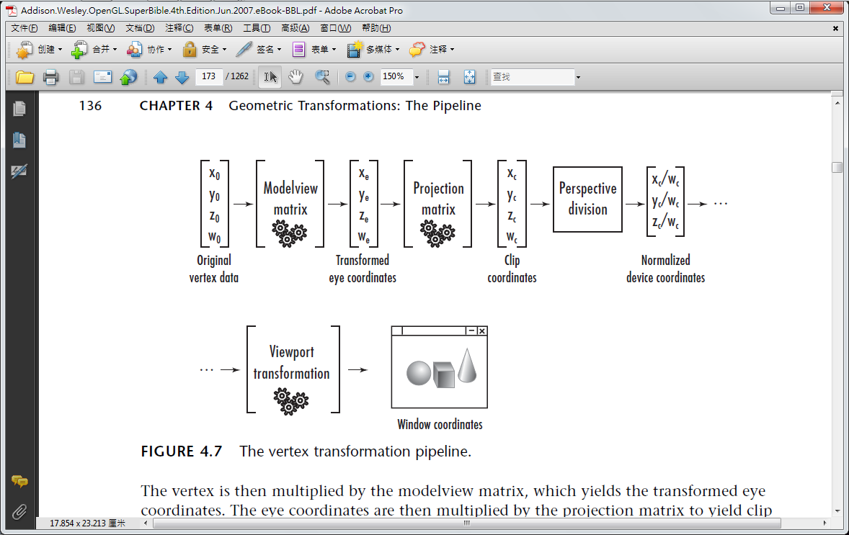
Graphics Pipeline (1/2)

Slide 10
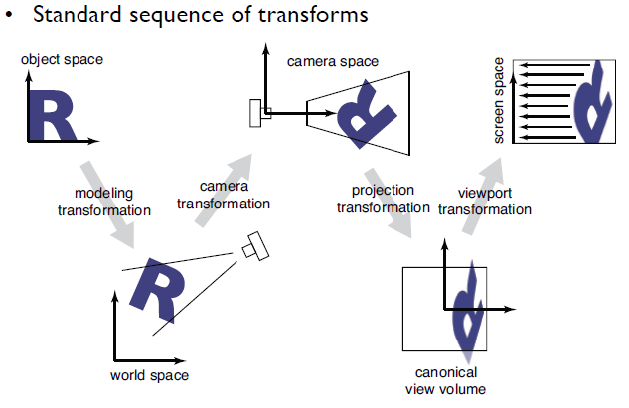
Graphics Pipeline (2/2)
Local Coordinate Space
World Coordinate Space
View Space
Canonical View Volume
Display Space

Slide 11
Coordinate Transformations
Two different world coordinate
z
y
How these two to be equal?
y
x
x
z
The World Coordinate of Maze
World Coordinate in OpenGL

Slide 12
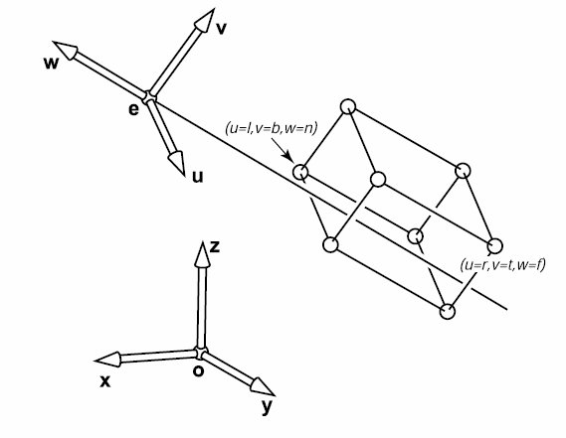
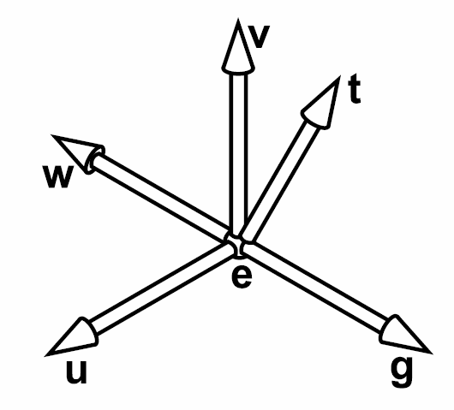
Coordinate Transformations
Arbitrary View Positions
Eye position: e
Gaze direction: g
View-up vector: t

Slide 13
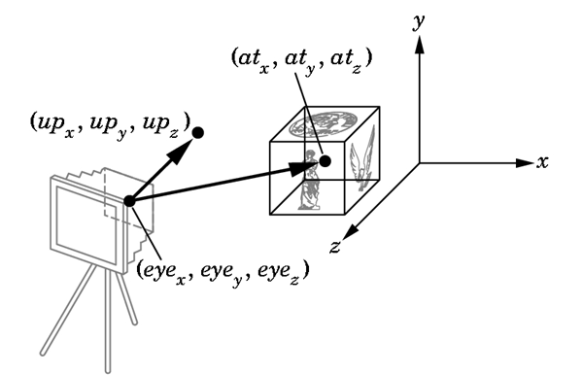
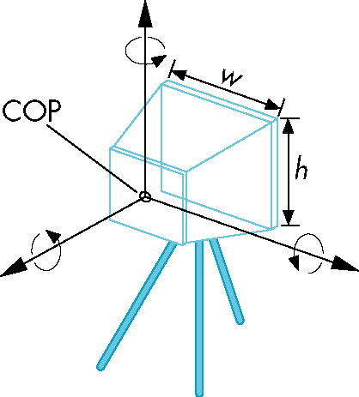

Slide 14

Coordinate Transformations
From World to View
y
y’
y’
g = -z
g
x
Translate rotation
z
x’
180+θ
z’= -g
x’
z’
The position and direction of viewer
The position and direction of viewer
The World Coordinate of Maze
View Coordinate of Maze

Slide 15
Coordinate Transformations
From View to Screen
y_{v}
P(x_{v} , y_{v} , z_{v} )
P(x_{s} , y_{s})
-z_{v}
0
d
View Plane

Slide 16
Coordinate Transformations
Transform Matrix

Slide 17
Coordinate Transformations
Transform Matrix

Slide 18
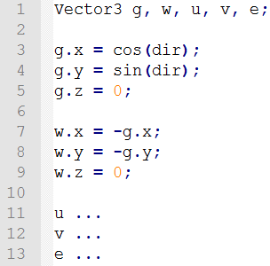
Coordinate Transformations
Transformation form World to View to Screen

Slide 19
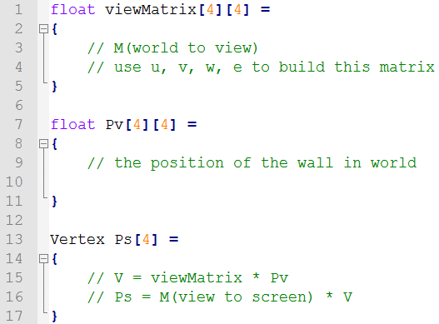
Coordinate Transformations
Transformation form World to View to Screen

Slide 20
Coordinate Transformations
Move origin to the center of the screen
y2
y’
y1
x1
x’
x2

Slide 21
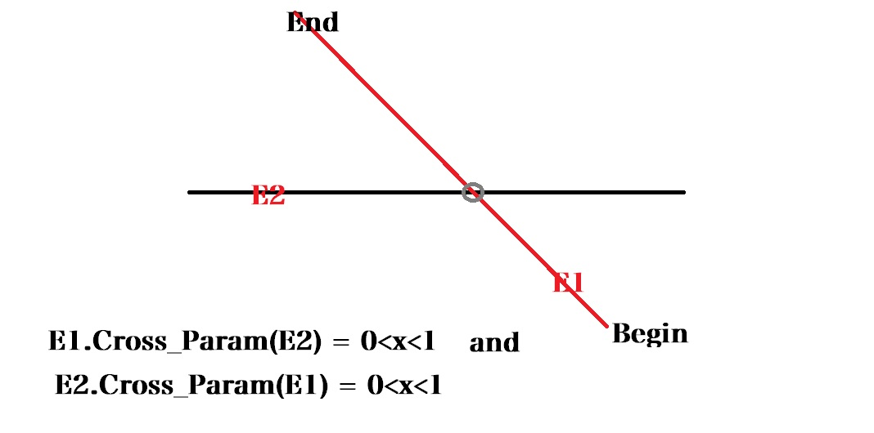
Cross_Param

Slide 22
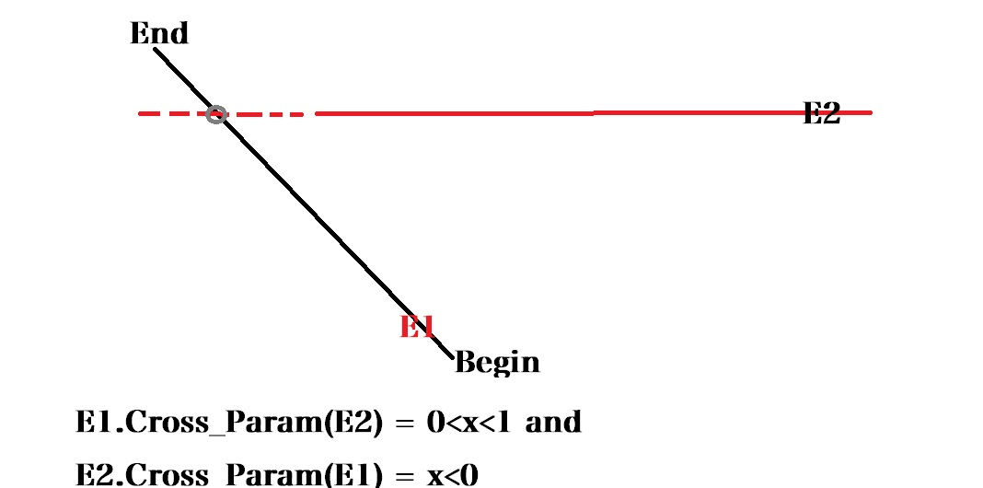
Cross_Param

Slide 23
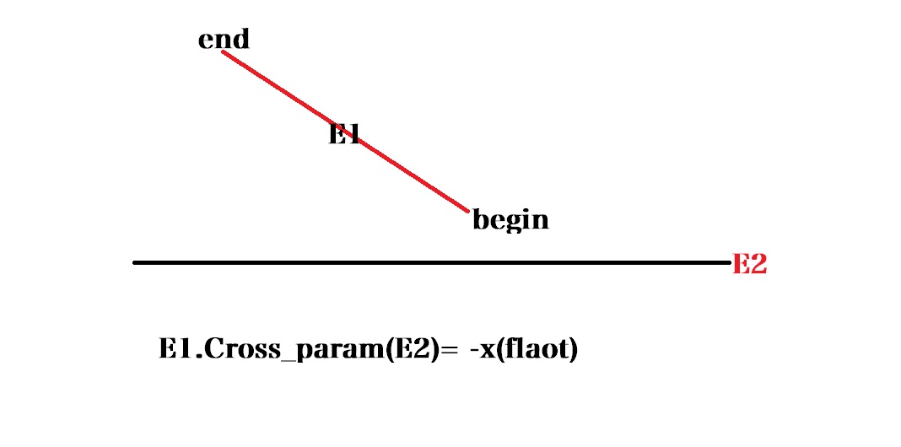
Cross_Param

Slide 24
Score
20 points for projecting a wall onto the screen with perspective projection and drawing it.
10 more points for correctly clipping walls to the view, for a single cell maze.
20 more points for doing the recursive visibility.
----------------------------------------------------------------------
Bonus
20 points for QT User Interface.
~25 points for doing something interesting or cool.

